Slide 1
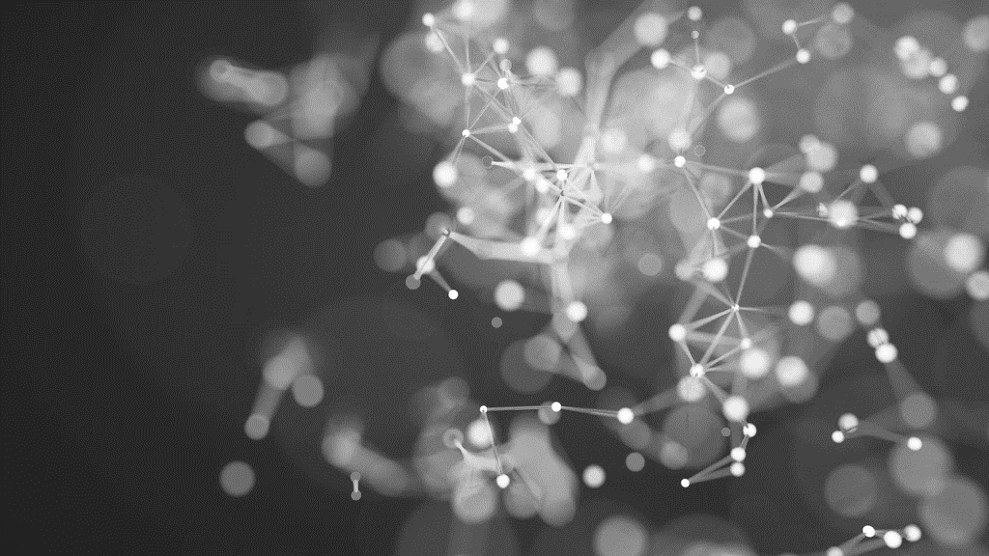
Advanced neural network data handling
Fred, Monique, Jade, Morgan & Emmanuel
ITAI 2377, 01-July-2025

Slide 2

What is a neural network?
Inspired by the brain: A neural network is a type of machine learning model designed to mimic how human brains process information—using layers of interconnected "neurons“ (mathematical functions) to recognize patterns.
Learns from data: It improves by adjusting internal weights based on examples, allowing it to make predictions, classify images, understand language, and more.
Layered structure: Neural networks are built from layers—input, hidden, and output—where each layer transforms the data slightly until the final result is produced.
Notes:
Each "neuron" is a small computation that takes in numbers (inputs), multiplies them by weights, adds a bias, and passes the result through an activation function (like ReLU or sigmoid). It’s like a tiny decision-maker.
Connected by weights: Neurons are connected to others in the next layer via weighted links. These weights determine how much influence one neuron has on another—just like synapses in the brain.
Organized in layers: Neurons are grouped into layers:
Input layer: Takes in raw data (like pixels or text).
Hidden layers: Transform the data through many neurons working in parallel.
Output layer: Produces the final result (like a label or prediction).
Each connection and neuron contributes to how the network "learns" patterns in data. During training, the network adjusts the weights to improve its accuracy—this is what makes it intelligent over time.
Internal Weights: Imagine you're trying to guess someone’s mood based on clues like:
Tone of voice
Facial expression
Words they use
If you learn that facial expression is the most reliable clue, you’ll start giving it more weight in your decision. Neural networks do the same—just with math.

Slide 3
Key concepts & terminology
Key Concepts:
Forward Propagation
Backpropagation
Overfitting
Terminology:
Epoch
Activation Function
Loss Function
Notes:
Forward Propagation The process of passing input data through the layers of a neural network to generate an output. It’s how the network makes predictions. Backpropagation The learning mechanism where the network adjusts its internal weights based on the error in its output. It uses gradients to minimize the loss function.
Overfitting When a model learns the training data too well—including noise or irrelevant patterns—causing it to perform poorly on new, unseen data.
Key Terminology
Epoch One complete pass through the entire training dataset. Neural networks are often trained over many epochs to improve accuracy.
Activation Function A mathematical function (like ReLU or sigmoid) applied to a neuron’s output to introduce non-linearity, allowing the network to learn complex patterns.
Loss Function A formula that measures how far off the network’s predictions are from the actual results. The goal of training is to minimize this loss.

Slide 4

Techniques & Approaches
Backpropagation with Gradient Descent
The foundational method for training neural networks. It adjusts internal weights by calculating how much each one contributed to the error, then nudges them in the right direction using gradients. Training a neural network with backpropagation is like teaching a student by pointing out exactly where they went wrong on a test, so they can tweak their thinking and do better next time.
Regularization (e.g., Dropout, L2)
Techniques like dropout randomly "turn off" neurons during training to make them more robust and less likely to overfit. L1/L2 regularization penalizes* overly complex models to improve generalization. Using dropout and regularization is like training an athlete by occasionally blindfolding them or adding weights, forcing them to rely on core skills and avoid overdependence on shortcuts.
Transfer Learning
Instead of training a model from scratch, you start with a pre-trained model (like ResNet or BERT) and fine-tune it for your specific task. This saves time and improves performance, especially with limited data. Using a pre-trained model is like hiring a chef who already knows how to cook, then just teaching them your favorite recipe, instead of starting from culinary school.
Notes:
How L2 penalization works:
The penalty term looks like this:
\lambda \sum_{i=1}^{n} w_i^2
where w_i are the model’s weights and \lambda is a hyperparameter that controls the strength of the penalty.
This encourages the model to keep its weights small but non-zero, which helps reduce overfitting without eliminating features entirely.
Unlike L1 regularization (which can zero out weights), L2 shrinks all weights evenly, smoothing the model and making it less sensitive to noise in the training data.

Slide 5
Examples
Medical Imaging (Healthcare) - Deep neural networks (like U-Net, CheXNet and Deep Learning Image Reconstruction (DLIR) by GE Healthcare) are used to detect diseases like cancer, diabetic retinopathy, and pneumonia from X-rays, MRIs, and CT scans. These models often outperform human radiologists in speed and, in some cases, accuracy.
Spam Filtering & Smart Replies (Communication) - Email services like Gmail and Outlook use neural networks to filter out spam, suggest smart replies, and even auto-categorize emails. These models learn from millions of examples to understand context and intent. Social media platforms like Facebook use CNNs to detect spam, fake reviews and malicious links in real-time.

Slide 6
Tools, libraries and platforms
Caffe (Convolutional Architecture for Fast Feature Embedding)
Developed by the Berkeley AI Research (BAIR) group.
Known for its speed and efficiency, especially in image classification and segmentation tasks.
Popular in academic research and embedded systems where performance is critical.
Offers a modular architecture and is written in C++ with a Python interface
Theano
One of the earliest deep learning libraries, developed by the Montreal Institute for Learning Algorithms (MILA).
Allows for symbolic differentiation* and efficient computation of mathematical expressions, especially on GPUs.
Though no longer actively developed, it laid the groundwork for libraries like Keras and is still used in some research settings.
Notes:
Symbolic differentiation is a method of computing the derivative of a mathematical expression by directly applying the rules of calculus to the expression itself—without plugging in any numbers.

Slide 7
Challenges and Best Practices
Data Quality & Quantity, Overfitting and Hyperparameter Tunings are 3 challenges typically faced in the neural network and deep learning domain.
Neural networks rely on having large, clean, and varied datasets. If the data is poor or limited, it can result in models that either don’t fit well or are biased.
Sometimes, models do great on the training data but struggle with new data. This usually happens when the network tends to memorize the training examples instead of learning to generalize from them.
Picking the right learning rate, batch size, number of layers, and so on can be tricky and often involves a lot of trial and error.
Apply dropout, L1/L2 penalties, and early stopping to prevent overfitting and improve generalization.
Start with pre-trained models and fine-tune them for your task—especially useful when data is limited.
Use tools like TensorBoard to track loss, accuracy, and gradients. This helps catch issues like vanishing gradients or overfitting early.

Slide 8
Emerging trends & research directions
Multi-Modal Transformers
These models process and integrate multiple types of data (e.g., text, images, audio) simultaneously.
Applications include healthcare diagnostics (combining scans + patient history) and autonomous vehicles (fusing sensor + visual data).
Hybrid Neural Architectures and Quantum Neural Networks
Researchers are combining different types of networks (e.g., CNNs + RNNs) to handle both spatial and temporal data—ideal for video analysis, robotics, and real-time systems.
Still in early stages, but quantum computing is being explored to dramatically accelerate neural network training and inference, especially for large-scale, high-dimensional problems.

Slide 9
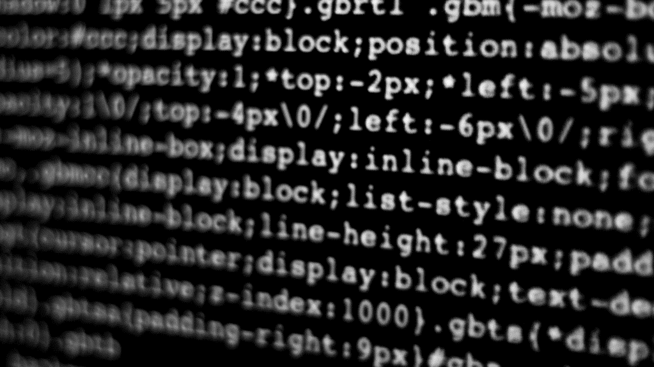
DEMO LINK

Slide 10
Summary & TAKEAWAYS
Neural networks are advanced machine learning models that take inspiration from how the human brain works. They’re great at recognizing complex patterns in data.
we’re seeing exciting developments like multi-modal models, graph neural networks, and federated learning, which are all expanding the capabilities of neural networks.
To get the best results, it's important to use clean and well-labeled data, keep an eye on your training process with visualization tools, and whenever you can, make use of pre-trained models.

Slide 11
References
Goodfellow, I., Bengio, Y., & Courville, A. (2016). Deep learning. MIT Press. Simplilearn. (2021, January 5). Neural network full course Neural network tutorial for beginners Neural networks [Video]. YouTube. https://www.youtube.com/watch?v=ob1yS9g-Zcs StatQuest with Josh Starmer. (2020, April 2). Neural networks clearly explained!!! [Video]. YouTube. https://www.youtube.com/watch?v=aircAruvnKk Wikipedia contributors. (2025, June 30). Neural network. Wikipedia. https://en.wikipedia.org/wiki/Neural_network Stack Exchange. (n.d.). Neural network references (textbooks, online courses) for beginners. Cross Validated. https://stats.stackexchange.com/questions/226911/neural-network-references-textbooks-online-courses-for-beginners

